Slide 1

Create Db2 service instance

Slide 2
Objectives
Use IBM cloud account to create and use resources
Create an instance of a Db2 service
Create Db2 service instance

Slide 3
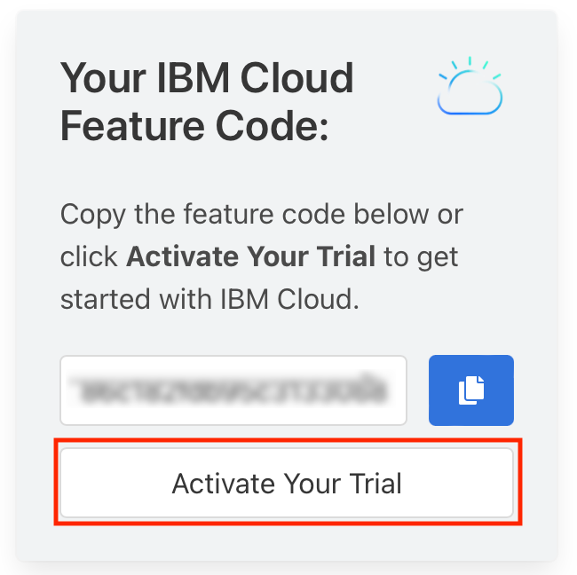
Create Db2 service instance
Create IBM Cloud account: do by your self
Create Db2 service instance

Slide 4
Create Db2 service instance
Access your database from your web browser.
IBM Cloud provides a large number of Data and Analytics services, including IBM Db2.
IBM Db2 is a next generation SQL database provisioned for you in the cloud.
IBM Db2: no need hardware setup or software installation and maintenance.
IBM Db2: store relational data, analyze data using a built-in SQL editor, or by connecting your own apps.
Create Db2 service instance

Slide 5
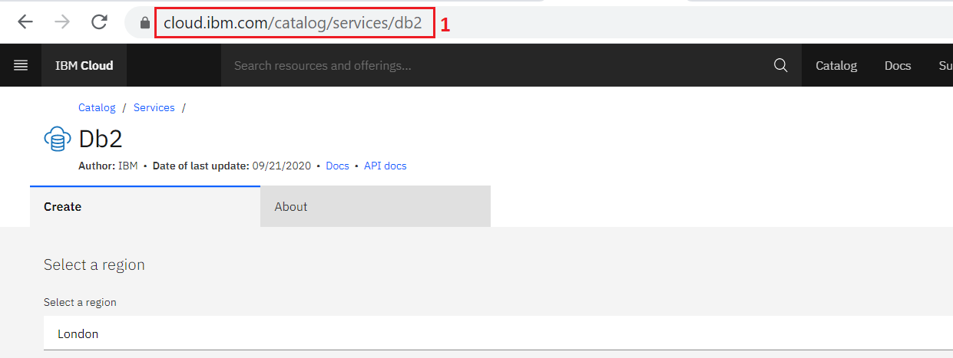
Create Db2 service instance
Login to IBM Cloud.
Go to the DB2 Services page on IBM Catalog.
Select a location where you want the service to be hosted.
Create Db2 service instance

Slide 6
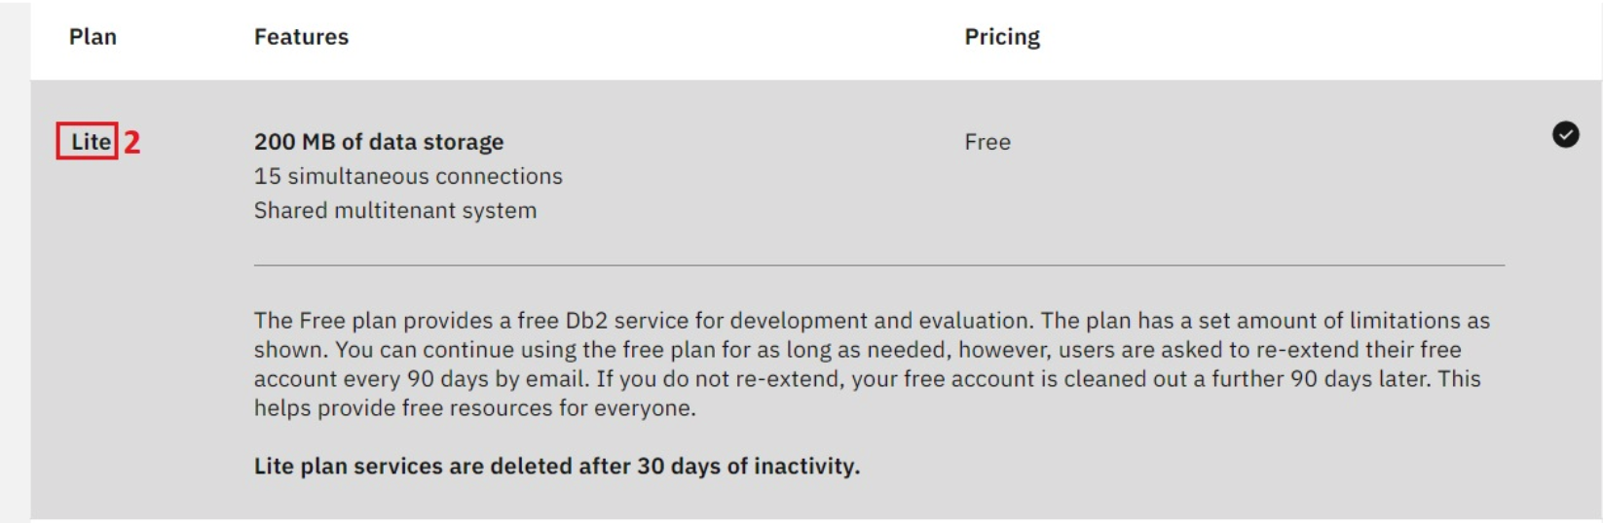
Create Db2 service instance
Select the Lite plan (it’s a free plan, and available only in DALLAS and LONDON at this point of time)
Create Db2 service instance

Slide 7
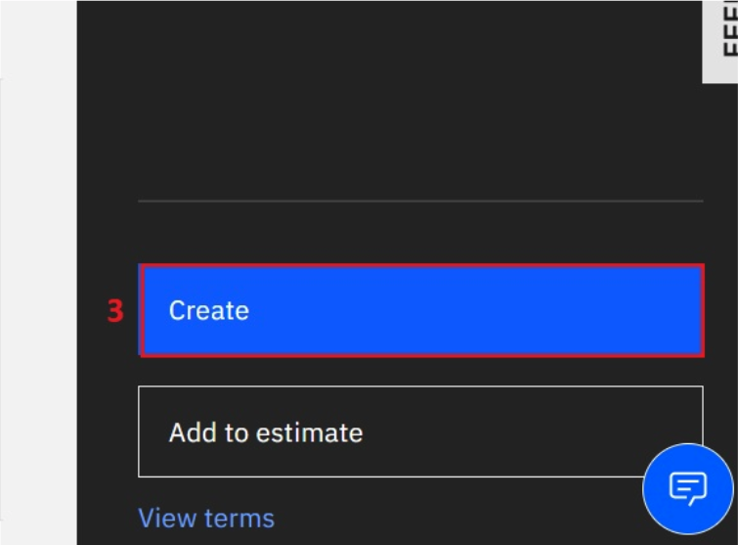
Create Db2 service instance
Click on the Create button→ you should see a Service Created message indicating that your instance of Db2 was created successfully.
Create Db2 service instance

Slide 8
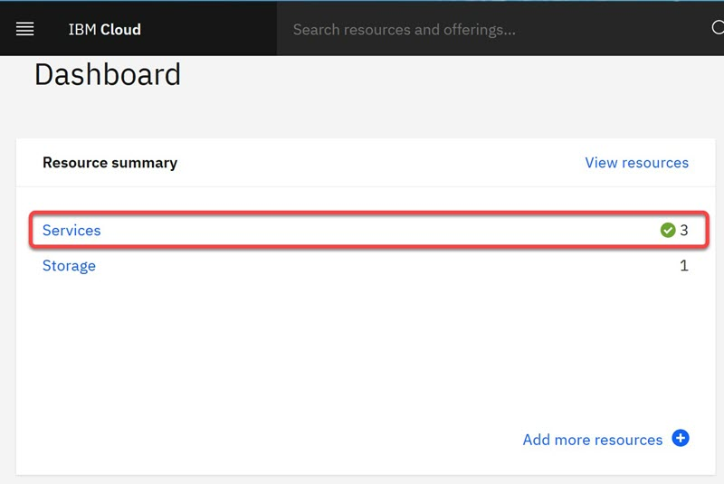
Locate and Explore the Db2 console
Go to your IBM Cloud dashboard at: cloud.ibm.com and click Services.
Create Db2 service instance

Slide 9
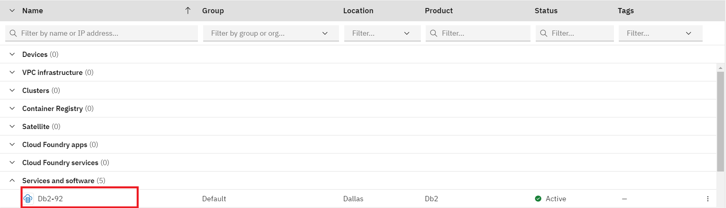
Locate and Explore the Db2 console
In the Resource list, expand the Services and locate and click on your instance of Db2
Create Db2 service instance

Slide 10
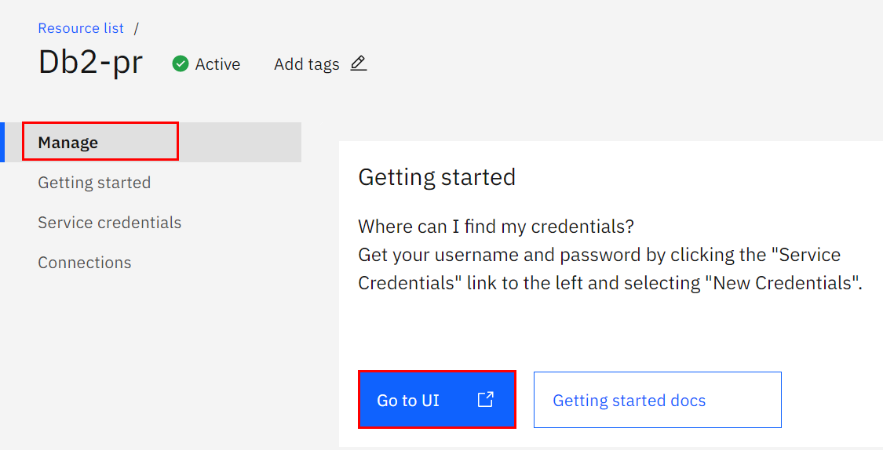
Locate and Explore the Db2 console
Opening the Db2-xx instance, and you see the below screen:
Create Db2 service instance

Slide 11
Summary
Use IBM cloud account to create and use resources
Create an instance of a Db2 service
Create Db2 service instance

Slide 12
Q & A
Create Db2 service instance

